Slide 1

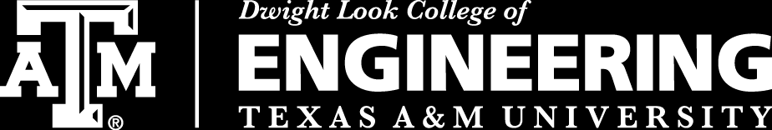
Team 6: Telescope Autofocuser
Bi-Weekly Update 4 Albin Myscich
Alonna Too-Chiobi
Camille Watson
Joseph Basdeo
Sponsor: Dr. Kevin Nowka
TA: Max Lesser
Notes:
Michelle

Slide 2
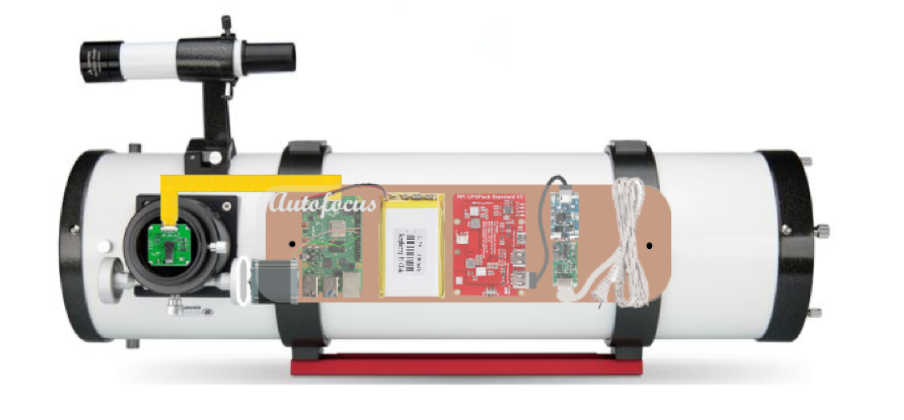
Project Summary
Telescope focusing & image processing automation
Product Will:
Stream current images to dev board using an imager
Autofocus using a stepper motor interface
Display focused image post processing through a GUI
Notes:
Kyle

Slide 3
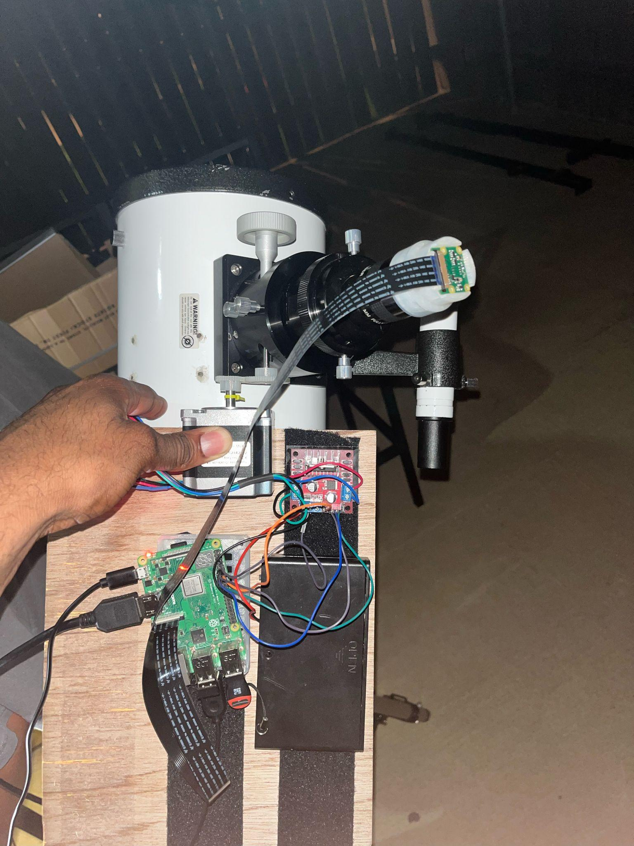
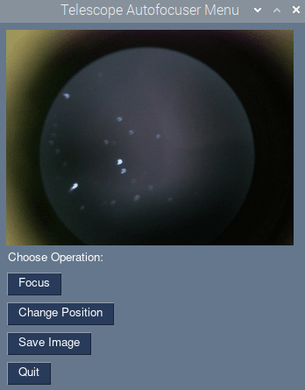
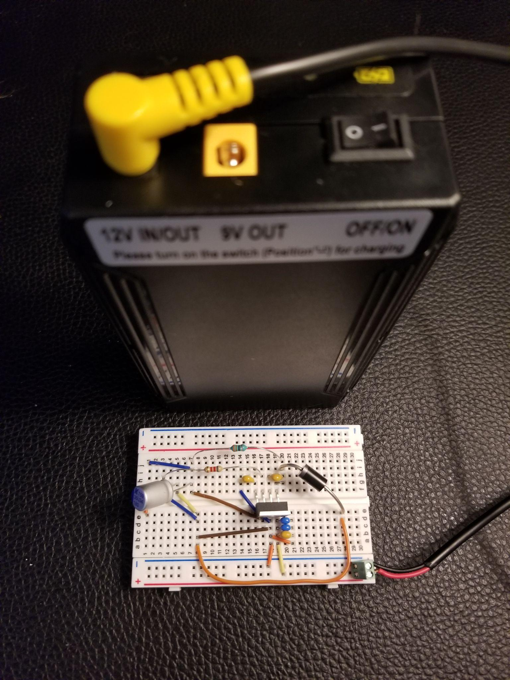
Integrated System Diagram
Image Display
Autofocus & Image Process Input
User Interface
Imager and motor integration with telescope and mount
Power Supply
Notes:
Eric

Slide 4
Project Timeline
Subsystem Designs and Testing (completed 4/21) | Integration of Motors, Autofocusing Program, and Imager Subsystems (to completed by 10/14) | Integration of Image Processor and GUI (to completed by 10/14) | Integration of Power Supply with all Dependent Subsystems (to completed by 10/14) | Final Integration (to complete by 10/28) | System Test (to complete by 11/11) | Validation (to complete by 11/28) | Demo and Report (to complete by 12/2)

Slide 5
Motor Assembly
Alonna Too-Chiobi
Accomplishments since last update 27.5 hrs of effort | Ongoing progress/problems and plans until the next presentation
Configured and tested new stepper motor Designed and tested motor gear assembly Integrated Imager and Motor assembly subsystems by testing image clarity at multiple step counts (up to 650) | Complete integration of Autofocusing Program and Motor Assembly subsystems Complete ongoing validation of Motor function while powered by Power Supply subsystem Assemble and program Eq-2 mount drive

Slide 6
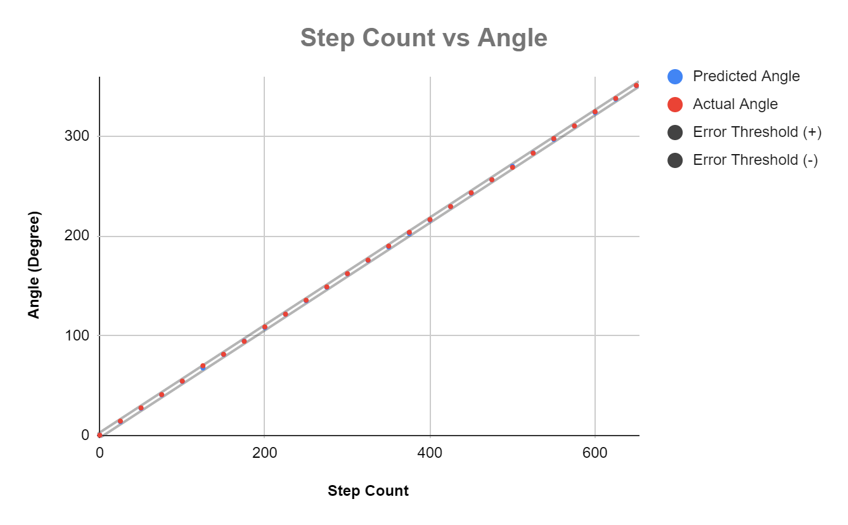
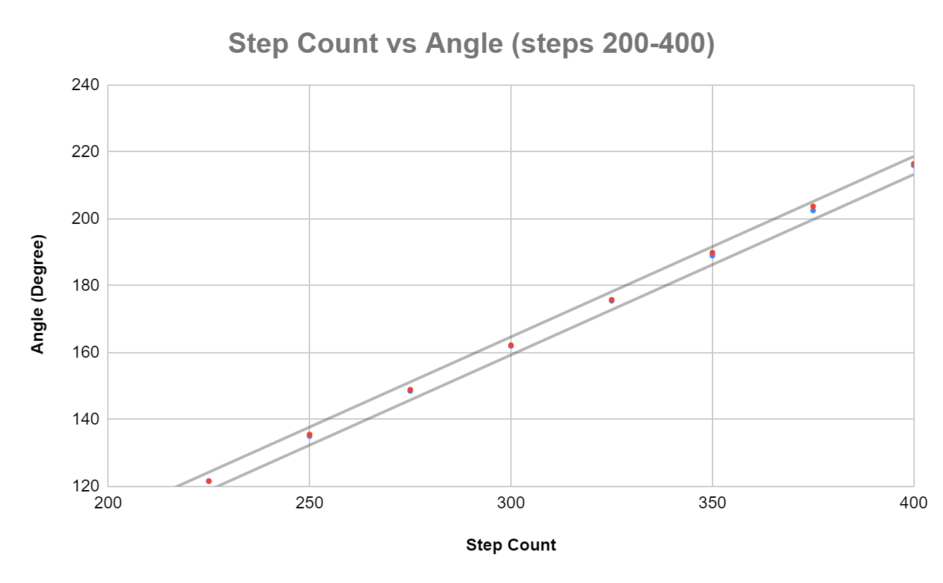
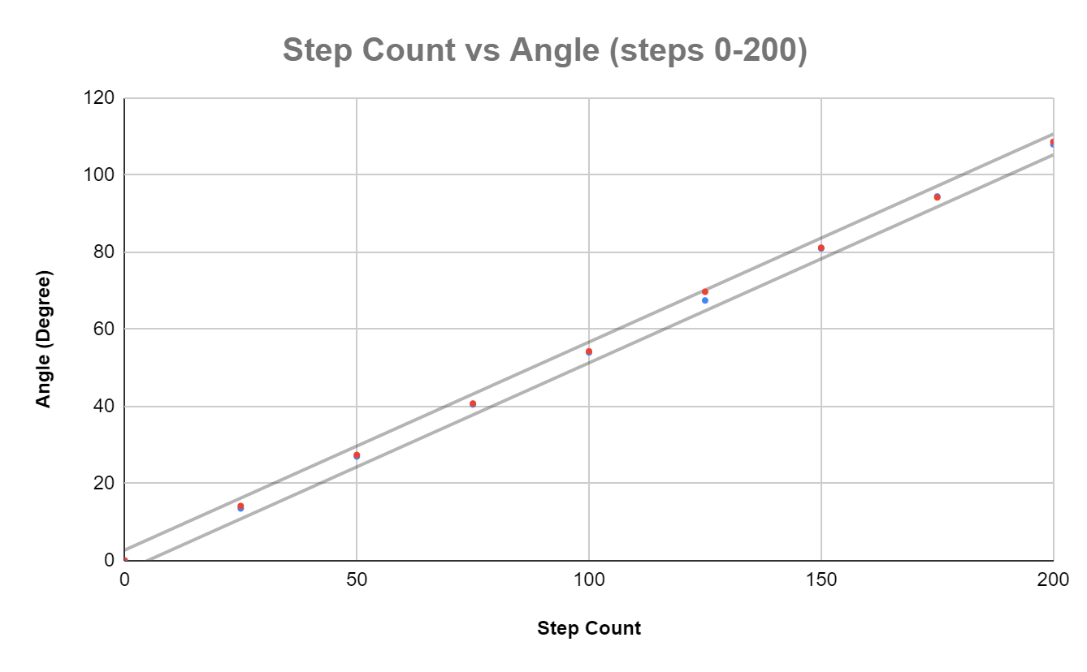
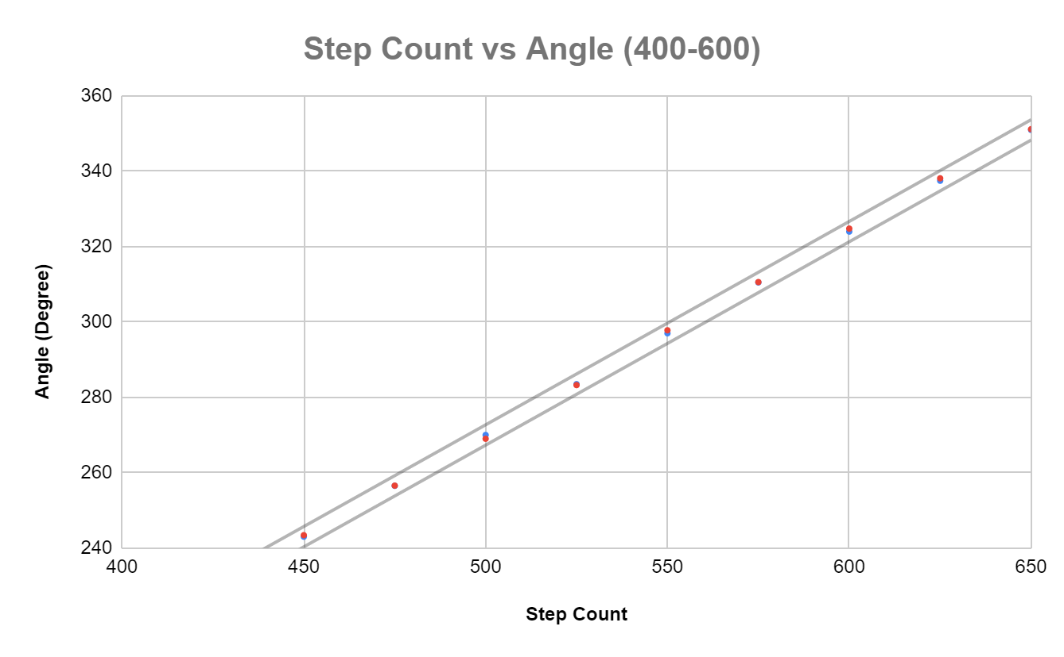
Motor Assembly
Alonna Too-Chiobi

Slide 7
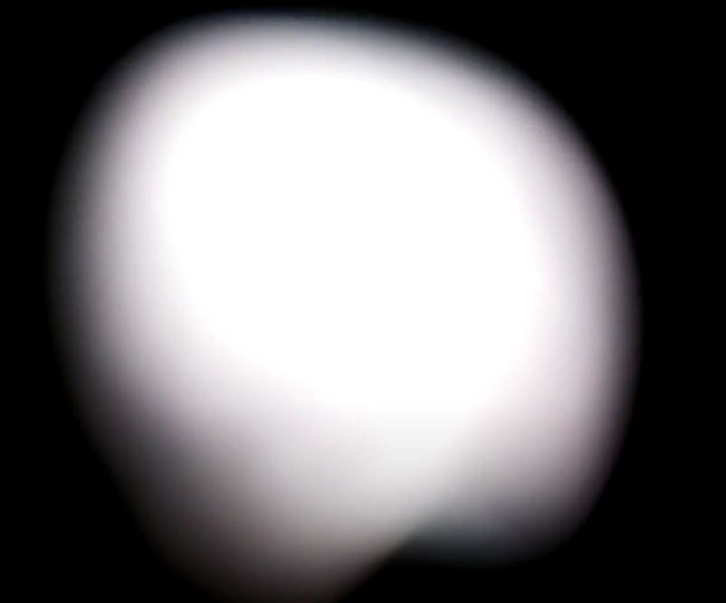
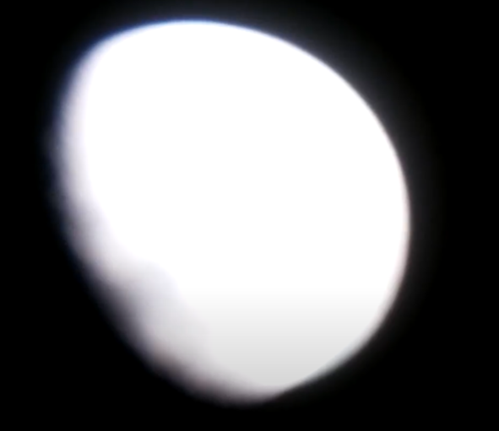
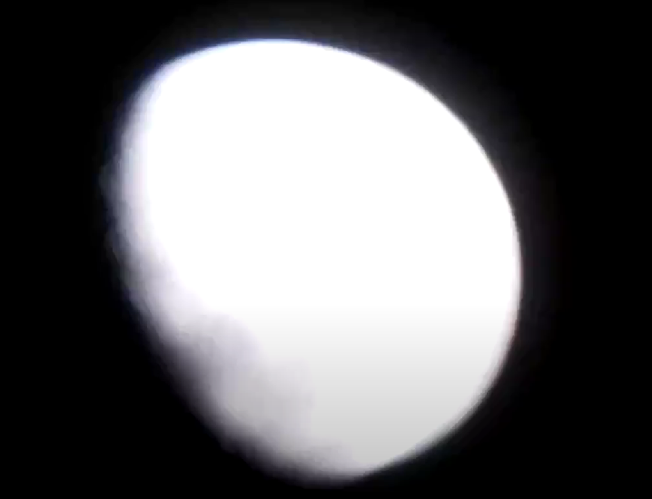
Motor Assembly & Imager Integration
Alonna Too-Chiobi
Step Count = 0
Step Count = 2050
(out of error threshold)
Step Count = 2055

Slide 8
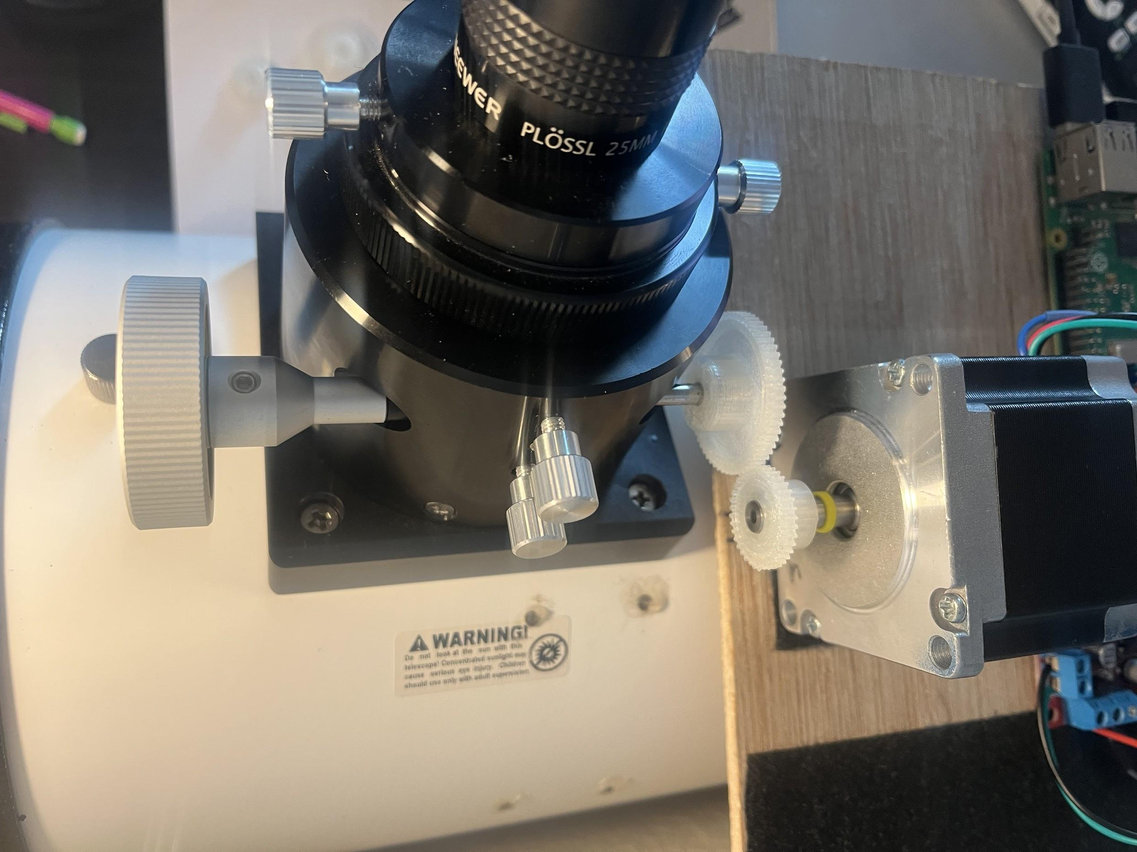
Motor Assembly
Alonna Too-Chiobi
Figure: Gear assembly
Gear Ratio = Teeth of driven gear/Teeth of driver gear = 1.667
400 steps = 360 degrees for motor shaft
666.8 steps = 360 degrees for focuser shaft

Slide 9
Imager & Mounting Assembly
Joseph Basdeo
Accomplishments since last update 14 hrs of effort | Ongoing progress/problems and plans until the next presentation
Implemented additional counterweight and tested telescope mount balance Calibrated ISO and shutter speed of camera for long exposure star images Integrated Imager and Motor Assembly subsystems gathering images based on step count supplied by stepper motor | Integrate and validate camera performance when supplied by power subsystem Complete & Integrate GUI with image processing and autofocusing programs Test new eyepieces with higher magnification

Slide 10
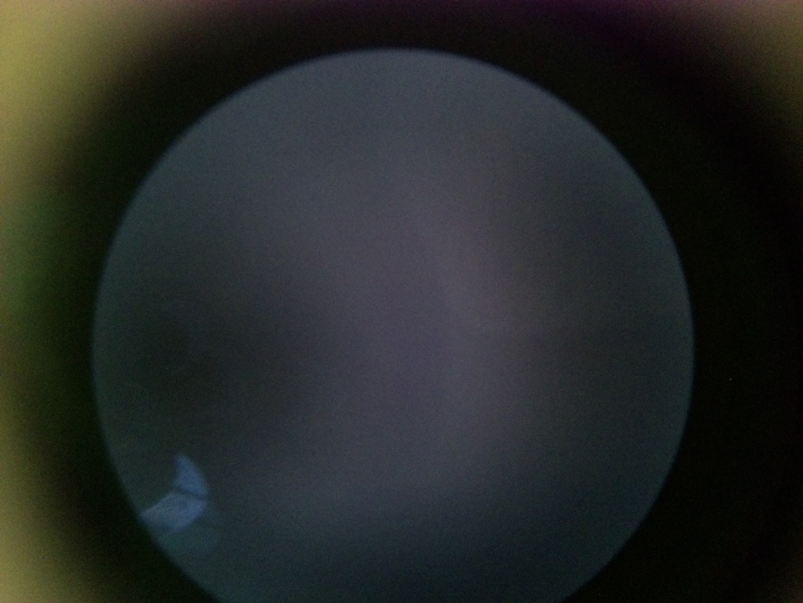
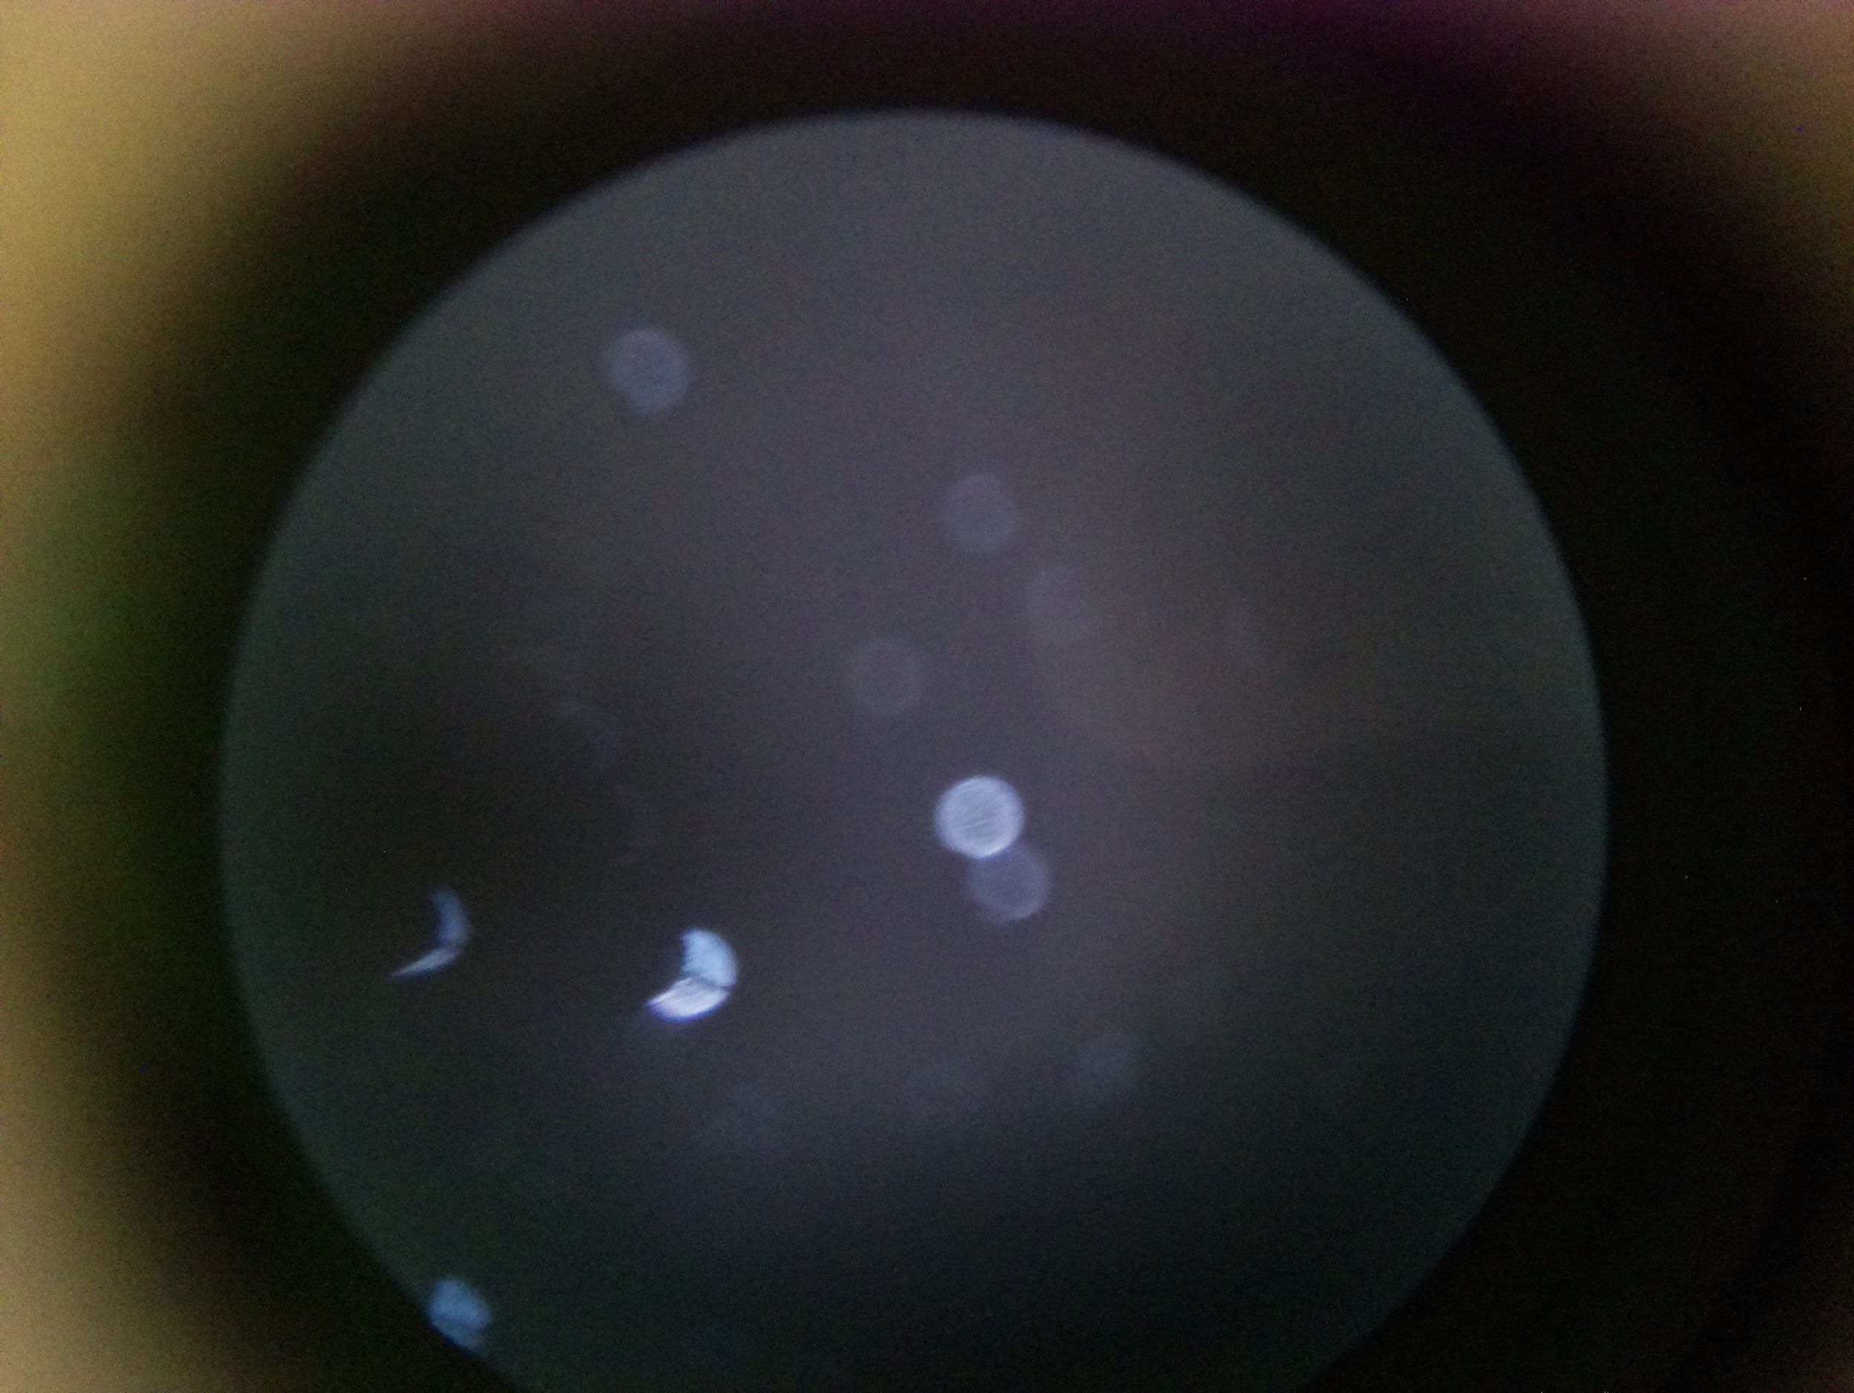
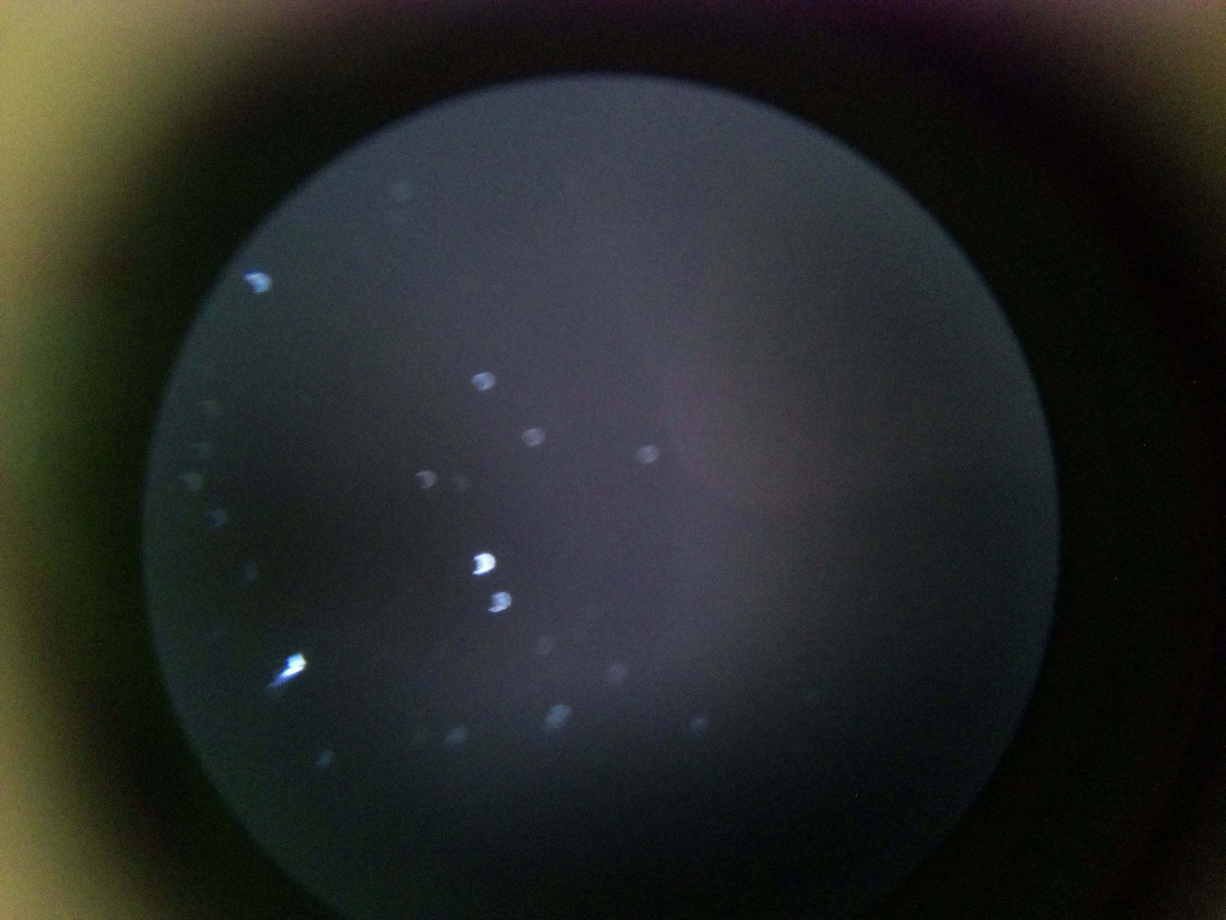
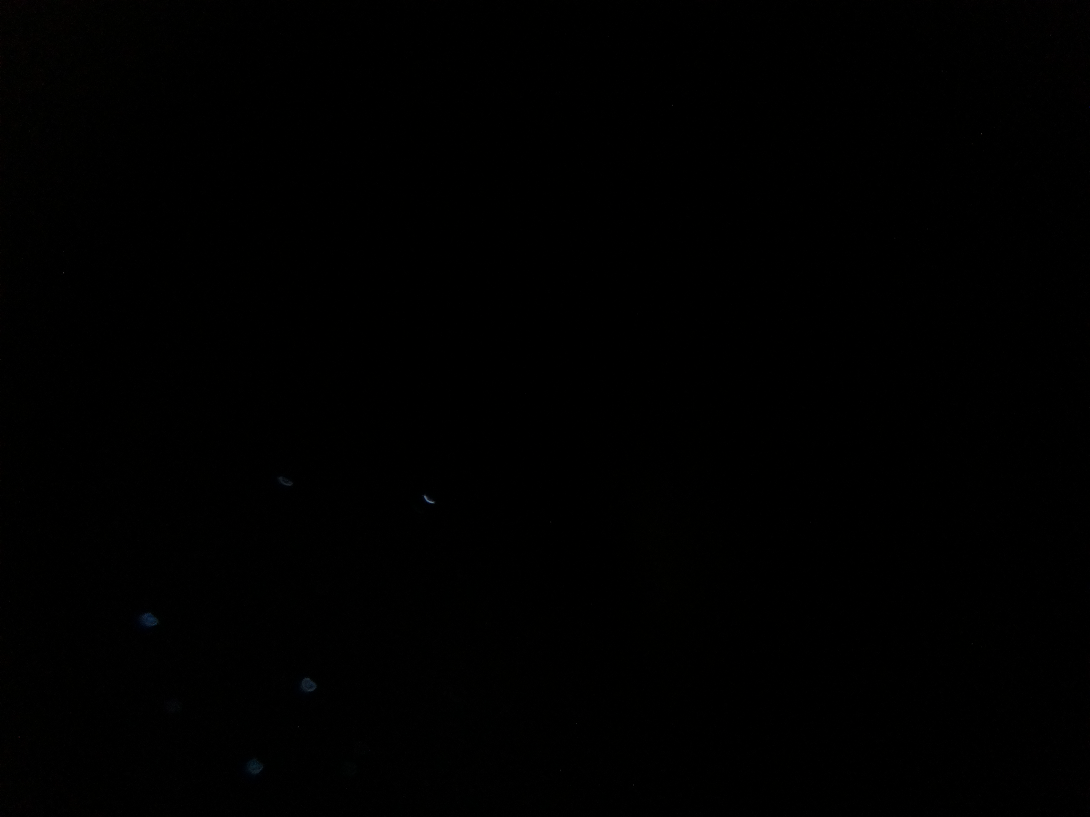
Imager & Mounting Assembly
Joseph Basdeo
Image 1: Unfocused (Reference)
Image 2: Midway focused
Image 3: Focused
Step count values
Image 1: 0
Image 2: 1200
Image 3: 2000
Image 4: 2000
Camera Configuration
ISO: 800
Shutter Speed: 6 seconds
Image 4: Focused (Default camera configuration)

Slide 11
Power Supply
Camille Watson
Accomplishments since last update 7 hrs of effort | Ongoing progress/problems and plans until the next presentation
Began integrating and testing breadboard version of power supply to motor subsystem Picked up the PCB | Finish soldering and testing the PCB (before next lab) Begin integrating and testing PCB with both loads

Slide 12
Power Supply
Camille Watson
Buck Converter Circuit
V_{in} | V_{out} (Without Load) | V_{out} (Without Load)
9 V | 4.988 V | 4.978 V
12 V | 4.988 V | 4.978 V
V_{out}
Buck Converter Breadboard Setup

Slide 13
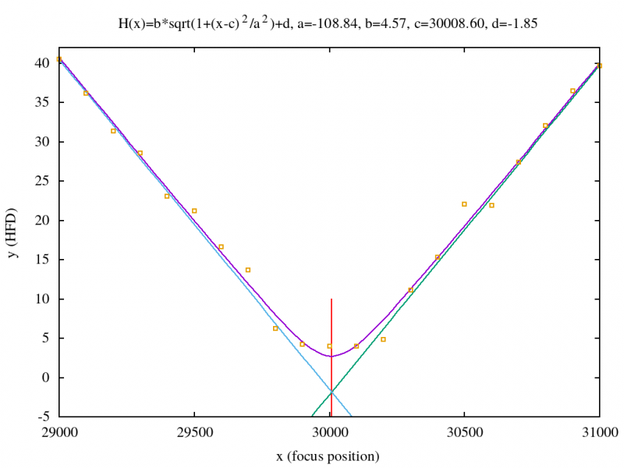
Image Processing & Autofocusing Program
Albin Myscich
Accomplishments since last update 25.3 hrs of effort | Ongoing progress/problems and plans until the next presentation
FoFi integration for non-terrestrial images Levenberg Marquart algo. Autofocus QA and Pi integration Finalize post processing quality assessment | Motor-App-Imager integration Connect FoFi to project UI Connect post processing to UI Outlier Detection
Notes:
The half flux diameter or HFD is a definition used by astronomers to define the star size in an astronomical image. Mainly due to the seeing, stars are not imaged as a dot but spread out like a Gaussian shape.
In a distribution, full width at half maximum (FWHM) is the difference between the two values of the independent variable at which the dependent variable is equal to half of its maximum value. In other words, it is the width of a spectrum curve measured between those points on the y-axis which are half the maximum amplitude. Half width at half maximum (HWHM) is half of the FWHM if the function is symmetric. The term full duration at half maximum (FDHM) is preferred when the independent variable is time.

Slide 14
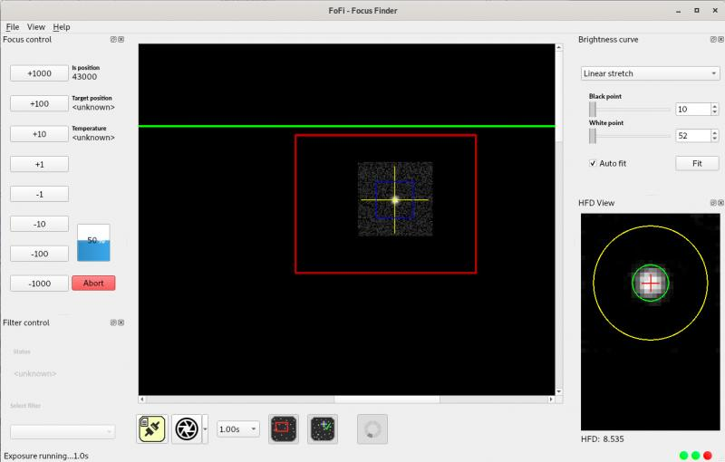
Image Processing & Autofocusing Program
Albin Myscich
This should all be test results! – show things working, functional test results, error checking, etc
Show test results for integrated systems

Slide 15
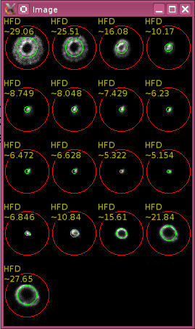
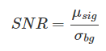
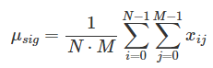
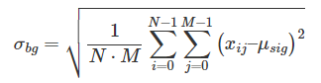
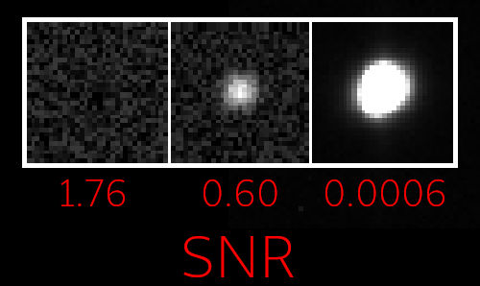
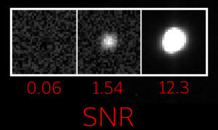
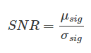
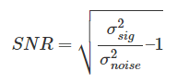
Image Processing & Autofocusing Program
Albin Myscich
Finding Stars
Determines the best focus based on the star diameter
Reference star
Derivative signal-to-noise ratio

Slide 16
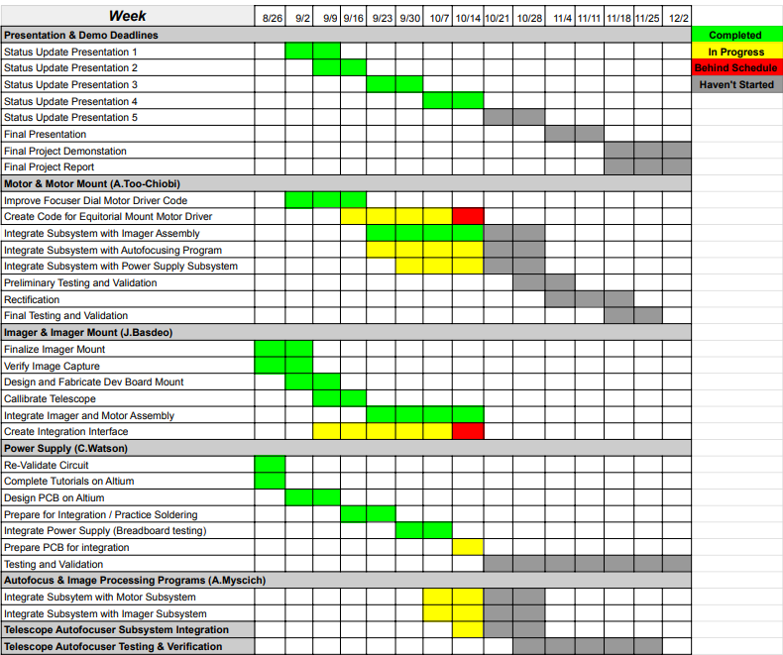
Execution & Validation Plan
Notes:
Michelle

Slide 17
Thank You
Questions?

